Slide 1

ELECTRICITY BILL & ENERGY
CONSUMPTION ANALYZER
An Excel-Based Data Analysis & Interactive Dashboard Project
Advanced Excel Data Analysis Project
Centre of Excellence for AI | Team Project Submission

Slide 2





Project Objective
Turning Raw Billing Data Into Insight
The project analyzes electricity consumption and billing data using Microsoft Excel and presents it through an interactive dashboard for easy understanding of energy usage patterns.
Using Excel formulas, Pivot Tables, and charts, raw transaction-level data is transformed into meaningful, decision-ready insights for households and businesses alike.
The Dashboard Helps Identify
High-Consuming Appliances
Which devices drive electricity usage
High-Billing Cities
Locations with higher total charges
Monthly Trends
Seasonal consumption patterns
Payment Collection
Paid vs. pending status by consumer
Electricity Bill & Energy Consumption Analyzer
2

Slide 3

Tools & Technologies Used
Excel features applied throughout the project
Microsoft Excel
Excel Tables
Sorting & Filtering
Pivot Tables
Pivot Charts
Slicers
SUM Function
SUMIFS Function
COUNTIF / COUNTIFS
AVERAGE Function
GETPIVOTDATA
Conditional Formatting
KPI Cards
Bar & Column Charts
Line Charts
Doughnut Charts
Electricity Bill & Energy Consumption Analyzer
3

Slide 4



Dataset Description
Column | Description
Bill ID | Unique ID for each electricity bill
Consumer Type | Residential or Commercial
City | Location of the consumer
Appliance | Main appliance driving consumption
Units Consumed | Electricity used, in kWh
Total Bill | Total electricity bill amount
Payment Status | Paid or Pending
Consumption Level | Low, Medium, or High
180
BILL RECORDS
13
DATA COLUMNS
Jan-Dec
YEAR 2025
Each record represents one electricity bill transaction.
Electricity Bill & Energy Consumption Analyzer
4

Slide 5

Data Preparation & Processing
1
Structure the Data
2
Analyze Time Trends
3
Categorize Consumers
Raw dataset organized into a structured Excel Table
Date & month columns used for monthly trend analysis
Split into Residential and Commercial types
4
Classify Appliances
5
Tag Status & Level
6
Build Pivots & Charts
Grouped by AC, Water Heater, Fridge, Washing Machine, TV, Microwave
Payments marked Paid/Pending; usage marked Low/Medium/High
Pivot Tables and Pivot Charts summarize and visualize results
Electricity Bill & Energy Consumption Analyzer
5

Slide 6


Key Performance Indicators
Snapshot metrics powering the dashboard
38,333 kWh
Rs. 3,24,958
105.0 kWh/day
AC
86% Paid
TOTAL ELECTRICITY CONSUMED
TOTAL BILL AMOUNT
AVERAGE DAILY USAGE
TOP CONSUMING APPLIANCE
PAYMENT COLLECTION RATIO
Electricity Bill & Energy Consumption Analyzer
6

Slide 7

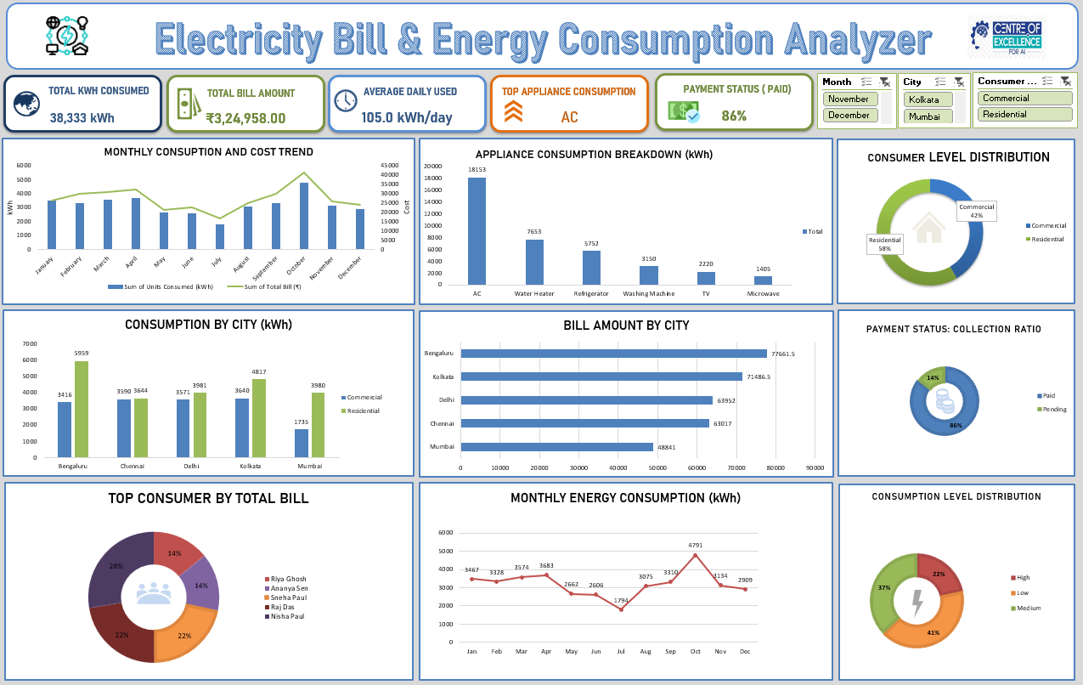
Interactive Dashboard
Filterable by Month, City, and Consumer Type
Month
City
Consumer Type
Electricity Bill & Energy Consumption Analyzer
7

Slide 8
Monthly Consumption Trend
Total energy usage (kWh) across the year
Insights
Peak usage in October at 4,791 kWh, likely driven by seasonal AC load.
Lowest usage in July at 1,794 kWh.
Consumption trends closely track total billing cost month to month.
Seasonal swings help plan capacity and billing cycles.
Electricity Bill & Energy Consumption Analyzer
8

Slide 9
Appliance Consumption Analysis
Total electricity use by appliance type (kWh)
Insights
AC is the single largest consumer — about 47% of total appliance usage.
Water Heater and Refrigerator are the next largest contributors.
TV and Microwave have the smallest impact on billing.
Targeting AC efficiency offers the biggest savings opportunity.
Electricity Bill & Energy Consumption Analyzer
9

Slide 10
Consumer Level Distribution
Share of Residential vs. Commercial consumers
Insights
Residential consumers make up 58% of all billing records.
Commercial consumers represent a significant 42% share.
The split helps tailor billing and usage policies by segment.
Both segments are tracked across every city in the dataset.
Electricity Bill & Energy Consumption Analyzer
10

Slide 11
City-Wise Consumption Analysis
Residential vs. Commercial usage by city (kWh)
Insights
Bengaluru shows the highest residential consumption at 5,959 kWh.
Mumbai has the lowest commercial usage among all cities.
Residential usage exceeds commercial usage in every city.
Kolkata and Delhi show consistently high demand across segments.
Electricity Bill & Energy Consumption Analyzer
11

Slide 12
City-Wise Bill Amount Analysis
Total electricity billing generated per city (Rs.)
Insights
Bengaluru generates the highest billing at Rs. 77,661.5.
Kolkata follows closely at Rs. 71,486.5.
Mumbai has the lowest total billing at Rs. 48,841.
High-billing cities are priority areas for revenue focus.
Electricity Bill & Energy Consumption Analyzer
12

Slide 13
Payment Status & Consumption Level
Collection ratio and usage-intensity distribution
Payment Status: Collection Ratio
Consumption Level Distribution
Electricity Bill & Energy Consumption Analyzer
13

Slide 14

Top Consumer Analysis
Consumers generating the highest total bill amounts
Insights
Riya Ghosh is the top consumer, contributing 28% of top-tier billing.
Sneha Paul and Raj Das each contribute a further 22%.
Together, the top 5 consumers highlight high-value accounts.
Useful for targeted account management and follow-up.
Electricity Bill & Energy Consumption Analyzer
14

Slide 15

Key Features of the Project
Interactive Excel dashboard
KPI cards for quick monitoring
Monthly consumption & bill trend analysis
Appliance-wise energy consumption analysis
City-wise consumption comparison
City-wise total bill comparison
Residential vs. Commercial distribution
Payment status & collection ratio analysis
Top consumer identification
Low / Medium / High consumption analysis
Interactive Month, City & Consumer Type slicers
Electricity Bill & Energy Consumption Analyzer
15

Slide 16

Learning Outcomes
Organizing and cleaning data in Excel
Using formulas & functions for analysis
Creating Pivot Tables for large datasets
Building different chart types for visualization
Designing KPI cards for reporting
Using slicers & filters for interactivity
Analyzing usage by appliance, city & consumer type
Understanding payment collection & pending bills
Improving dashboard design & visualization skills
Collaborating effectively as a team
Electricity Bill & Energy Consumption Analyzer
16

Slide 17

Team Contribution
Work divided across three members for efficient delivery
Member 1
Member 2
Member 3
Data Collection & Preparation
Pivot Tables & Analysis
Dashboard & Reporting
Sourced the raw dataset and performed Excel data cleaning to prepare it for analysis.
Built Pivot Tables, applied formulas, and carried out the core data analysis.
Designed the dashboard, created charts, handled formatting, and prepared the report.
Electricity Bill & Energy Consumption Analyzer
17

Slide 18

Conclusion
The Electricity Bill & Energy Consumption Analyzer demonstrates how Microsoft Excel can drive effective data analysis and visualization — turning 180 billing records into a centralized, interactive view of energy usage and revenue performance.
38,333 kWh
Rs. 3,24,958
AC
86%
CONSUMED
TOTAL BILLED
TOP APPLIANCE
COLLECTED
Overall, the project strengthened practical skills in Advanced Excel — Pivot Tables, formulas, data visualization, dashboard development, and business data analysis.
Electricity Bill & Energy Consumption Analyzer
18

Slide 19

Future Improvements
Automatic dashboard updates when new data is added
Advanced forecasting of future electricity consumption
Identification of abnormal or unusually high usage
Automated alerts for pending payments
Integration with Power BI for advanced visualizations
Adding macros or VBA automation
Predictive models for electricity bill estimation
Electricity Bill & Energy Consumption Analyzer
19

Slide 20

Thank You
Questions & Discussion Welcome
GitHub Repository
Electricity-Bill-Energy-Consumption-Analyzer
Electricity Bill & Energy Consumption Analyzer
20

